Slide 1
Introduction to States

Slide 2
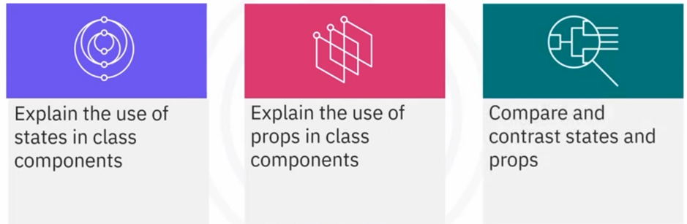
What you will learn

Slide 3
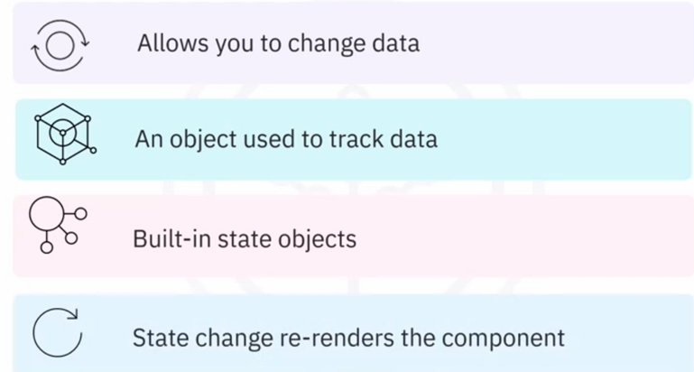
What is state?

Slide 4
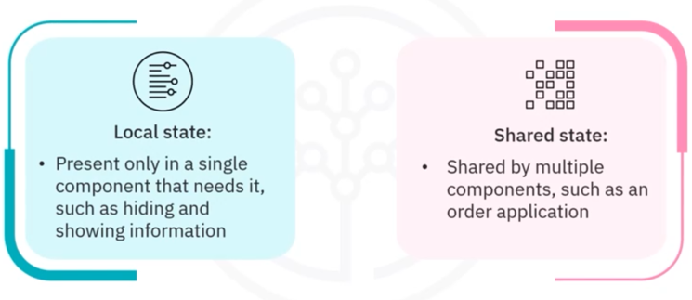
Types of React state

Slide 5
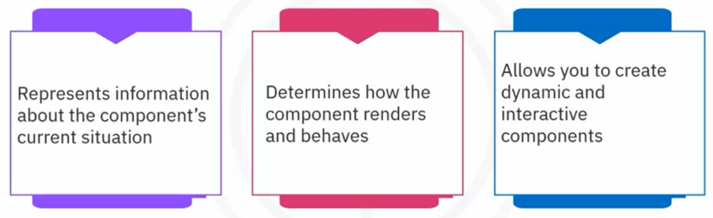
States in React components

Slide 6
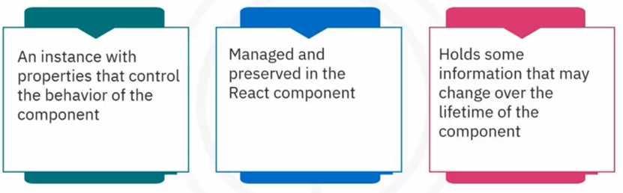
States in class components

Slide 7
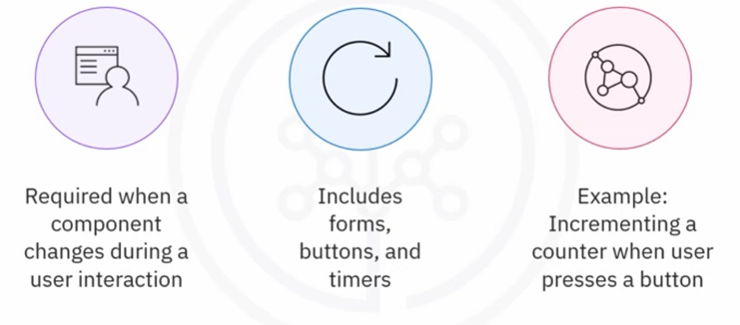
When to use states

Slide 8
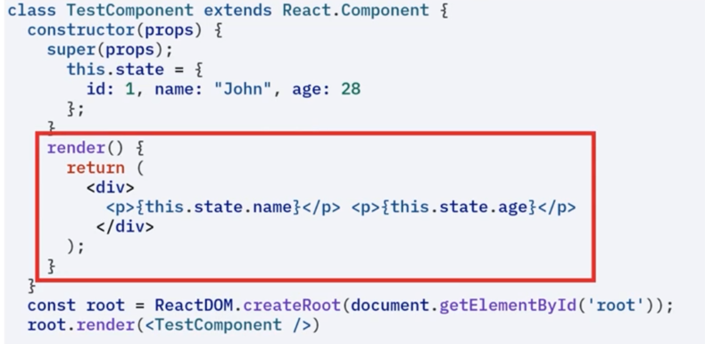
State Example

Slide 9
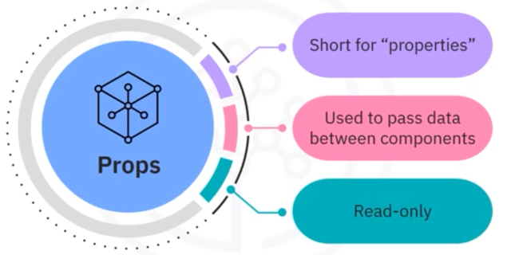
Props

Slide 10
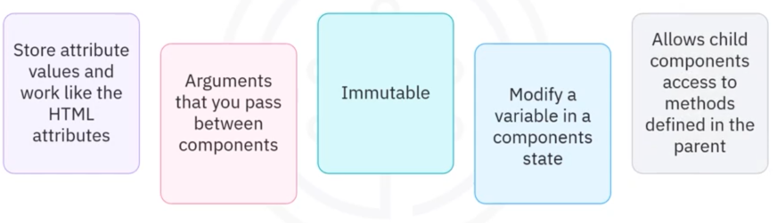
Props behavior

Slide 11
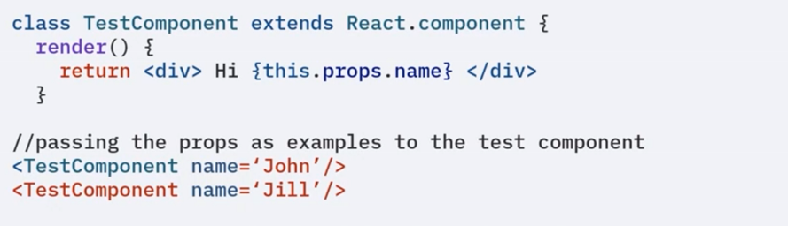
Props Example

Slide 12
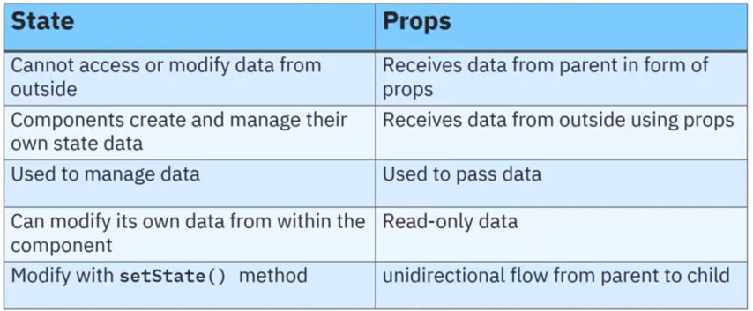
State Versus Props

Slide 13
Recap
In this video, you learned that:
• A state represents information about the component's current
situation
• The state allows you to create interactive components
• Changes in a state cause the component to re-render
• Use props to pass data between components in a unidirectional
flow
• Components create and manage their own data with their state,
whereas they receive data from outside using props

